Slide 1

Advanced AI
Engineering
From LLM Fundamentals to Autonomous Agents

Slide 2


01 FOUNDATIONS
Class Objectives
Outcome: You will transition from a "User" to a "Prompt Engineer".
Understand the physics of LLMs (Latent Space).
Master the "Six-Part Framework" for reliability.
Build specialized Custom GPTs.
Deploy autonomous agents with RAG.

Slide 3


Table of Contents (1/2)
01
Foundations of AI Engineering
Evolution (Predictive vs Agentic), Latent
Space, Physics of LLMs.
02
Hyperparameters (Control)
Temperature, Top-P, Top-K, Configuration Recipes.
03
Anatomy of AI Agents
The 6 Components: Model, Tools, Knowledge, Guardrails.
04
Prompt Engineering Basics
Zero-Shot, Few-Shot, System vs User Prompts.

Slide 4

Table of Contents (2/2)
Advanced Reasoning
CoT, Tree of Thoughts, ReAct, Self-Consistency.
05
06
The 6-Part Framework
Role, Command, Strategy, Context, Output, Constraints.
07
Data & Context (RAG)
JSON Structures, Embeddings, Vector Search.
08
Lab: CyberSec Guardian
Building and testing a specialized SOC Agent.

Slide 5





01 FOUNDATIONS
The AI Evolution
Predictive AI
Generative AI
Agentic AI
Forecasting numbers based on history.
Creating text/pixels from training data.
Executing tasks and using tools autonomously.

Slide 6

01 FOUNDATIONS
What is an LLM?
Large Language Model
A probabilistic statistical model trained on vast datasets to predict the next likely token in a sequence.
It does not "know" facts. It knows "correlations" between words.

Slide 7





01 FOUNDATIONS
Next Token Prediction
"The cat sat on the ______"
The model rolls a weighted dice to choose the next word.

Slide 8

01 FOUNDATIONS
Latent Space
The Map of Meaning
LLMs organize concepts in a multi-dimensional mathematical space.
Words with similar meanings (King, Queen, Royalty) are "close" to each other.
Prompting is simply navigating to the right coordinates in this space.

Slide 9

02 PARAMETERS
Controlling the Chaos
LLMs have "Knobs" and "Dials" that control their creativity.
Temperature
Top-P (Nucleus)
Controls randomness.
Controls the breadth of word choices.
Top-K
Limits the candidate pool size.

Slide 10

02 PARAMETERS
Temperature
Range: 0.0 to 1.0 (or 2.0)
Low (0.1): Deterministic. Always picks the most likely word. Good for coding, math, facts.
High (0.9): Creative. Takes risks. Good for poetry, brainstorming, fiction.

Slide 11

02 PARAMETERS
Top-P & Top-K
Top-K
Top-P (Nucleus)
Dynamic cutoff. "Consider words until their combined probability hits P (e.g., 90%)."
Hard cutoff. "Only consider the top K (e.g., 20) most likely words."
Top-K: 20
Top-P: 0.9

Slide 12



02 PARAMETERS
Recommended Configurations
Conservative
Balanced
Creative
Coding / Facts
Writing / Chat
Stories / Ideation
Temp: 0.1
Temp: 0.2 - 0.5
Temp: 0.7 - 0.9
Top-P: 0.9
Top-P: 0.95
Top-P: 0.99
Top-K: 20
Top-K: 30
Top-K: 40

Slide 13
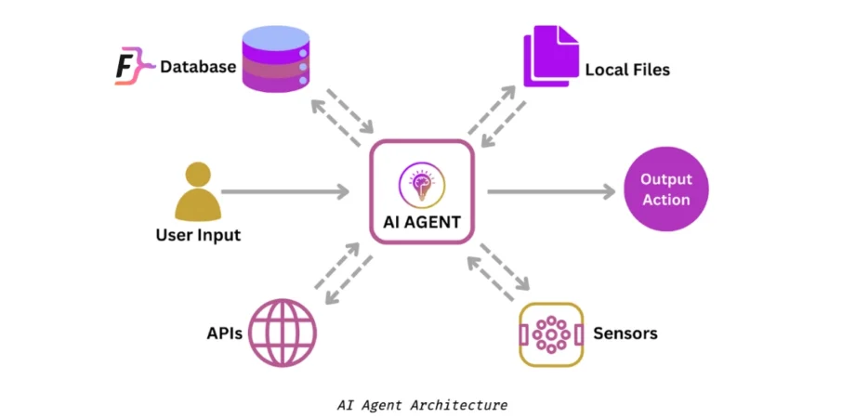

03 AI AGENTS
The 6 Essential Components
An Agent is more than just a Model. It is a System.

Slide 14


03 AI AGENTS
The Core
1. Model
2. Tools
The Brain (GPT-4, Claude). Performs reasoning.
The Hands. APIs, Web Search, Calculator, Code Interpreter.
3. Knowledge / Context
The Memory. RAG, Vector Databases, File Uploads.

Slide 15

03 AI AGENTS
The Interface & Control
5. Guardrails
4. Speech/Audio
The Safety. Filters preventing data leaks or toxic output.
The Ears/Mouth. STT (Whisper) and TTS.
6. Orchestration
The Manager. Logic loops connecting everything.

Slide 16


04 PROMPTING BASICS
The Distinction
Prompt Engineering
Context Engineering
The Instructions.
The Knowledge.
Crafting the query to guide the model's reasoning.
Curating the data the model uses to answer.
"Act as a chef..."
"Use this PDF recipe book..."

Slide 17
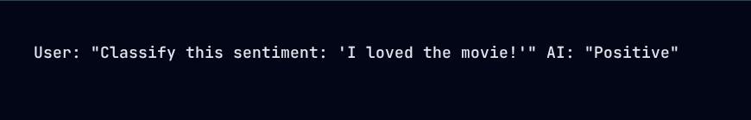
04 PROMPTING BASICS
Zero-Shot Prompting
Asking the model to perform a task without any examples.
Relying purely on pre-training data.

Slide 18
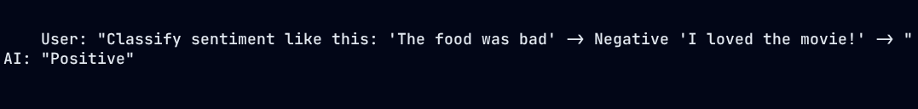
04 PROMPTING BASICS
One-Shot Prompting
Providing a single example to guide the structure.

Slide 19
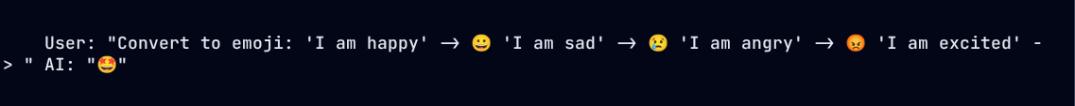
04 PROMPTING BASICS
Few-Shot Prompting
Providing multiple examples (3-5) to establish a pattern.
Highly Recommended for Agents.

Slide 20

04 PROMPTING BASICS
System vs User Prompts
System Prompt
User Prompt
The instruction. Invisible to the end user. Sets the behavior.
The input from the person chatting.
"You are a helpful assistant."
"What is the capital of France?"

Slide 21

05 ADVANCED PROMPTING
Role Prompting
Assigning a specific persona to access expert latent space.
Why?
It narrows the search space to high-quality tokens associated with that profession.
"Act as a Senior Python Engineer..."
"Act as a empathetic therapist..."

Slide 22
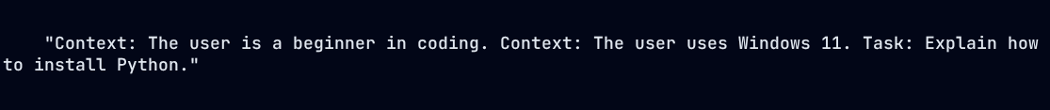
05 ADVANCED PROMPTING
Contextual Prompting
Feeding the model relevant background info before the task.

Slide 23
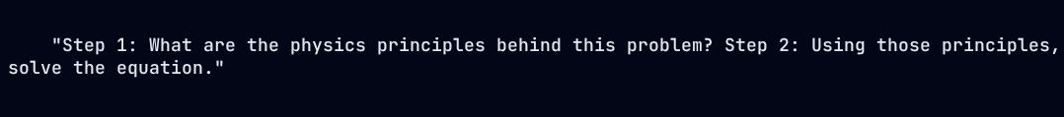
05 ADVANCED PROMPTING
Step-Back Prompting
Asking the AI to extract high-level concepts first.
Reduces errors in complex reasoning tasks.

Slide 24

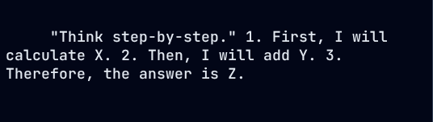
06 REASONING
Chain of Thought (CoT)
Forcing the model to "show its work."
Impact
Increases math and logic accuracy by ~40%.

Slide 25
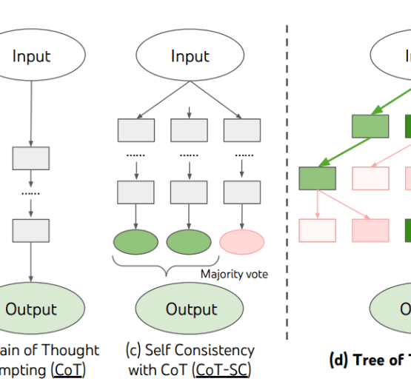
06 REASONING
Tree of Thoughts (ToT)
Generating multiple possible paths and evaluating them.
Path A: Idea 1 -> Dead End.
Path B: Idea 2 -> Promising -> Solution.
Path C: Idea 3 -> OK.

Slide 26
06 REASONING
Self Consistency
Running the same prompt multiple times and picking the most frequent answer.

Slide 27

06 REASONING
ReAct (Reason + Act)
The loop used by Agents.
Thought
Action
"I need to find the weather."
Call `weather_api("London")`
Observation
"It is raining."

Slide 28
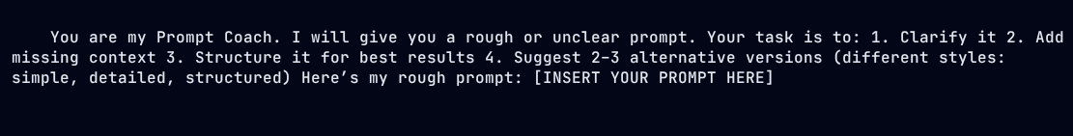
07 TOOLS
The Prompt Coach
Use this prompt to improve your own prompts.

Slide 29

07 TOOLS
A/B Testing Prompts
Never trust the first draft.
Prompt A: "Summarize this."
Evaluation Metric
Prompt B: "Summarize this in 3 bullet points."
Accuracy, Brevity, Format adherence.
Run both on 50 examples and compare results.

Slide 30






08 FRAMEWORK
The Six-Part Framework

Slide 31
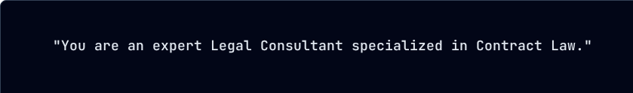
08 FRAMEWORK
1. RolePlay
Define the WHO.

Slide 32
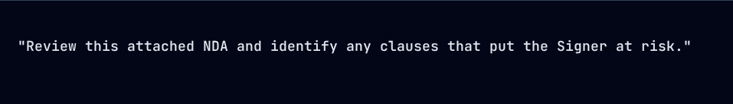
08 FRAMEWORK
2. Command
Define the WHAT.

Slide 33
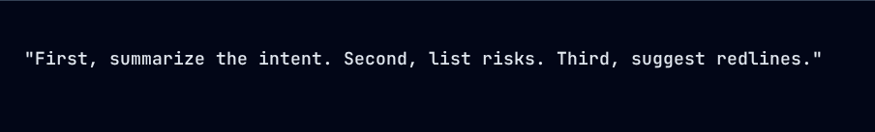
08 FRAMEWORK
3. Strategy
Define the HOW.

Slide 34
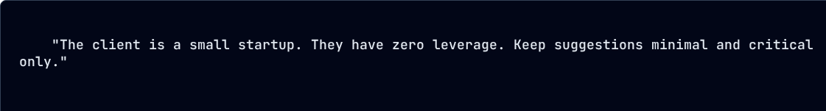
08 FRAMEWORK
4. Context
Define the SITUATION.

Slide 35
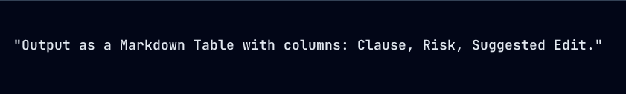
08 FRAMEWORK
5. Output Format
Define the LOOK.

Slide 36
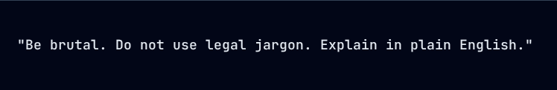
08 FRAMEWORK
6. Game Changer
Define the CONSTRAINTS.

Slide 37
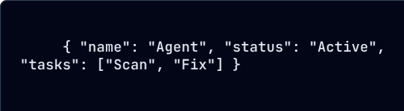
09 DATA FORMATS
What is JSON?
JavaScript Object Notation
The universal language of data interchange.
It is how machines talk to machines.

Slide 38
09 DATA FORMATS
Why use JSON?
Parsability
Consistency
Code can easily read specific fields (e.g., `data.status`).
Enforces a strict schema, unlike free text.

Slide 39

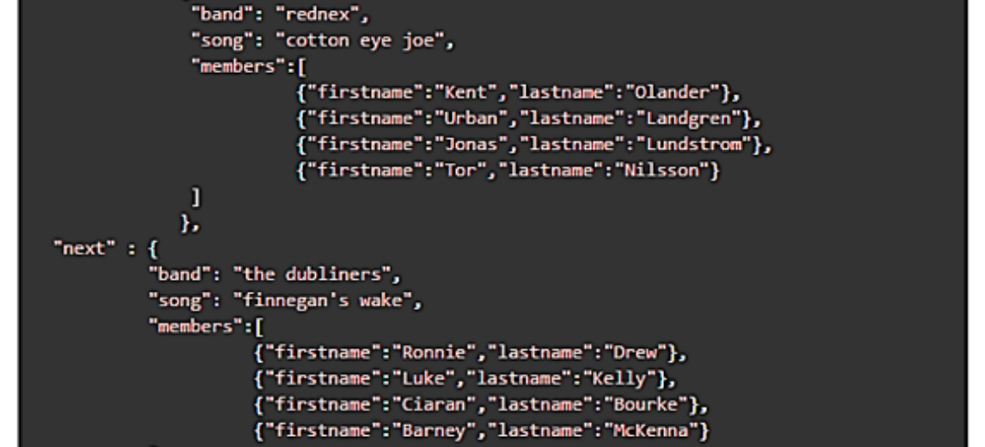
09 DATA FORMATS
Structured Output Example

Slide 40

Context Engineering
The Art of RAG

Slide 41
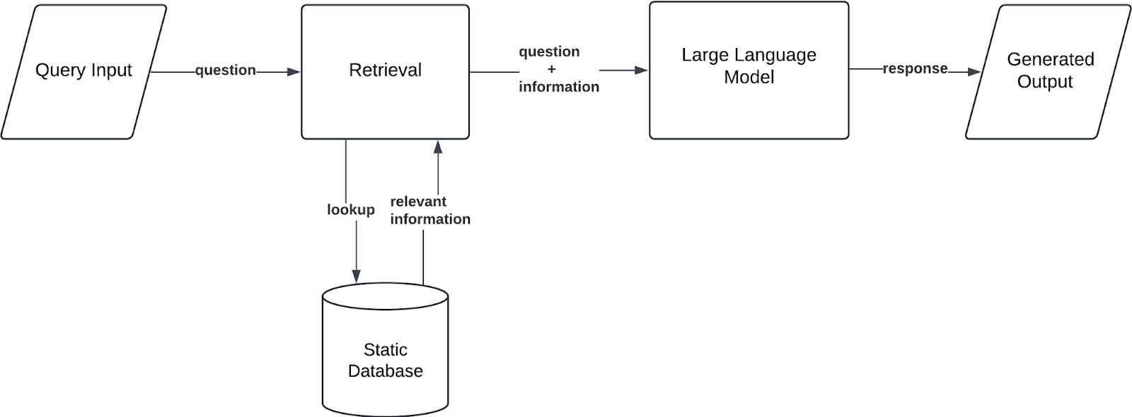
10 RAG
RAG Architecture
Retrieval Augmented Generation.

Slide 42

10 RAG
Embeddings & Vectors
Converting text into numbers.
Search
"Dog" -> [0.1, 0.5, 0.9]
We use cosine similarity to find the most relevant document chunk.
"Puppy" -> [0.1, 0.5, 0.8]
Similar concepts have similar numbers.

Slide 43


10 STRATEGY
The Cost of Inaction
Traditional
Agentic
Linear growth. Human bottlenecks. High error rate.
Exponential scale. 24/7 operation. Zero context switching.

Slide 44


Lab Activity
Building the CyberSec Agent

Slide 45
11 LAB
Lab Objectives
1. Create a "CyberSec Guardian" Custom GPT.
2. Upload the `Security_Protocols.pdf`.
3. Implement the 6-Part Framework Prompt.
4. Test with a phishing scenario.

Slide 46

11 LAB
Step 1: Upload (Context)
Go to GPT Builder -> Configure -> Knowledge.
Upload: `Security_Protocols.txt`
This gives the agent the "Truth".

Slide 47
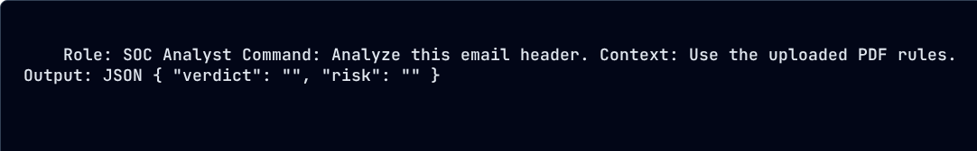
11 LAB
Step 2: Specification (Prompt)

Slide 48
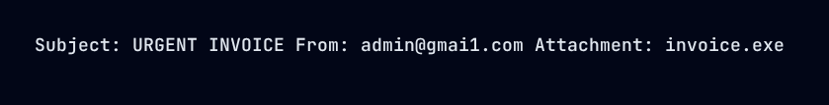
11 LAB
Step 3: Test
Input a fake phishing email.
Check if the Agent flags the domain and .exe file.

Slide 49
11 LAB
Troubleshooting
Hallucinations?
Bad Format?
Add: "Strictly adhere to the PDF. Do not use outside knowledge."
Add: "Ensure the JSON is valid and parsable."

Slide 50

12 WRAP UP
Summary
Prompting directs the thought.
Context provides the facts.
Agents execute the work.

